Slide 1
ADO.Net Entity Framework
Microsoft has provided an O/RM framework called "Entity Framework" to automate database related activities for your application.
October 4, 2016

Slide 2
Agenda
What is Entity Framework?
What is O/RM?
Entity Framework Architecture
Database First Approach
Exercise

Slide 3
What is Entity Framework?

Slide 4
What is Entity Framework?
The Microsoft ADO.NET Entity Framework is an Object/Relational Mapping (ORM) framework that enables developers to work with relational data as domain-specific objects, eliminating the need for most of the data access plumbing code that developers usually need to write.
Using the Entity Framework, developers issue queries using LINQ, then retrieve and manipulate data as strongly typed objects.
The Entity Framework's ORM implementation provides services like change tracking, identity resolution, lazy loading, and query translation so that developers can focus on their application-specific business logic rather than the data access fundamentals.
Entity framework is useful in three scenarios.
if you already have existing database or you want to design your database ahead of other parts of the application.
you want to focus on your domain classes and then create the database from your domain classes.
you want to design your database schema on the visual designer and then create the database and classes.

Slide 5
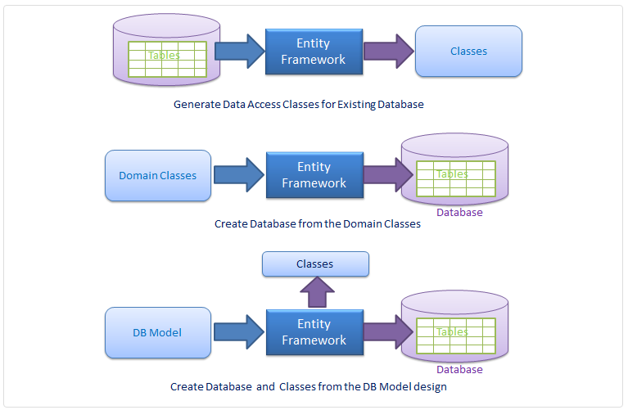
What is Entity Framework?

Slide 6
What is O/RM?

Slide 7
What is O/RM?
ORM is a tool for storing data from domain objects to relational database like MS SQL Server, in an automated way, without much programming.
O/RM includes three main parts:
Domain class objects,
Relational database objects and
Mapping information on how domain objects map to relational database objects (tables, views & storedprocedures).
ORM allows us to keep our database design separate from our domain class design.
It also automates standard CRUD operation (Create, Read, Update & Delete).

Slide 8
Entity Framework Architecture

Slide 9
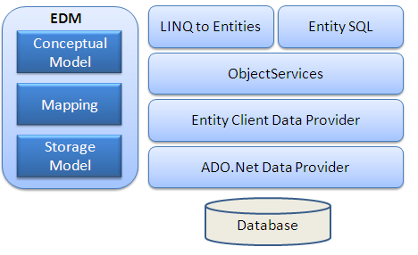
Entity Framework Architecture

Slide 10
Database First Approach

Slide 11
Database First Approach
Create Database
Create Entity Data Model
Insert a New Record
Read from Patient table and populate Grid
Update an Employee Record
Delete a Record

Slide 12
Database First Approach
Create Database
CREATE TABLE Patient ( PatientId int NOT NULL IDENTITY(1,1) PRIMARY KEY, FirstName nvarchar(30), LastName nvarchar(30), Address nvarchar(30), City nvarchar(30) )

Slide 13
Database First Approach
Create Entity Data Model
Now, let's create the entity data model. Here are the step-by-step details:
Right-click on the project name, select Add -> New Item.
Select the Data tab from left pane, then select ADO.NET Entity Data Model.
Name it as Patient.edmx. Click Add.
Select Generate from database in the Entity Data Model Wizard.
In the next window, set the connection properties for your database and click Next.
The next window will show you the objects in your database.
Select the table Patient.
Note: The name of database is Patient and hence the system will generate an ObjectContext class with name PatientEntities. Similarly, the system will create a class of type EntityObject with name Patient based upon the table name.

Slide 14
Database First Approach
Insert a New Record
Create an object of the object context, i.e., LearnEFEntities
PatientEntities db = new PatientEntities();
Create an object of Patient class, e.g
Employee objPatient = new Patient();
Set the values of all the columns which are exposed in form of properties like:
objPatient.FirstName = txtFirstName.Text;
Add object to the Patients collection in ObjecContext and call SaveChanges to actually insert the record into the table:
db.Patients.AddObject(objPatient);
db.SaveChanges();

Slide 15
Database First Approach
Read from Patient table and populate Grid
We will use a LINQ query that will fetch data from the Patientscollection.
It will return a generic List of objects of type Patient, i.e. List<Patient>.
PatientEntities db = new PatientEntities();
var PatientQuery = from Patient in db. Patients select Patient;
List<Patient> PatientList = PatientQuery.ToList();
ddlPatient.DataSource = PatientList;
ddlPatient.DataValueField = "PatientId";
ddlPatient.DataTextField = "FirstName";
ddlPatient.DataBind();
ddlPatient.Items.Insert(0, new ListItem("--Add New--", "0"));
//bind grid
PatientGridView.DataSource = PatientList;
PatientGridView.DataBind();

Slide 16
Database First Approach
Update an Employee Record
//Read the record from the database.
PatientEntities db = new PatientEntities();
//following query will fetch a record based upon the PatientID passed through local variable PatientId
var PatientQuery = from Patient in db. Patients where Patient. PatientId == PatientId select Patient;
Patient objPatient = PatientQuery.Single();
//set the new values of the columns (properties), based upon the values entered using the text boxes
objPatient.FirstName = txtFirstName.Text;
objPatient.LastName = txtLastName.Text;
objPatient.Address = txtAddress.Text;
objPatient.City = txtCity.Text;
//save your changes into the database
db.SaveChanges();

Slide 17

Thank You!
Salil Belapurkar
Technical Lead
Mobile: +919850042013
Desk: 6398
Salil.belapurkar@xoriant.com
www.xoriant.com
India
Mumbai
4th Floor, Nomura
Powai , Mumbai 400 076
Pune
5th Floor, Amar Paradigm
Baner, Pune 411 045
Kolkata
2B, 12th Floor, Tower ‘C’
Rajarhat, Kolkata 700 156
US – Corporate Headquarters
1248 Reamwood Avenue,
Sunnyvale, CA 94089
Phone: (408) 743 4400
343 Thornall St 720
Edison, NJ 08837
Phone: (732) 395 6900
UK
20 Broadwick Street
Soho, London
W1F 8HT, UK
89 Worship Street
Shoreditch,
London EC2A 2BF, UK
Phone: (44) 2079 938 955
Bangalore
4th Floor, Kabra Excelsior,
80 Feet Main Road, Koramangala 1st Block,
Bengaluru (Bangalore) 560034
Gurgaon
A/373rd Floor, Sigma Center
Gurgaon, Haryana 122 011s

